Slide 1

Organization Supporting Social Inclusion
Leaving care, accommodation, supported living, accessibility
Maia Shishniashvili
Founder, Hand in Hand
2018

Slide 2
Country specifics
Population of the country – around 4 000 000
Large Residential facilities
  187 people with disabilities
Psychiatric Clinics
  448 people with mental health problems
“Community based housing” (mini-institutions)
  100 people
Families
Notes:
In the beginning of my presentation, I would like to say few words about the characteristics of my country – Georgia is the small country located between Turkey and Russia with the population of around 4 million. However, when you go out, you rarely see people with disabilities. They are not seen in the streets, shops, or at work. There are some changes for children but not for adults as of right now.
Where are the people with disabilities in Georgia? Where do they live?
I’d like to provide some figures: …
So called “community based housing”, which serve 24 people in one facility - mini institutions
The majority of them live with their families in a good care, but unfortunately they are not supported to be included in a larger community).

Slide 3
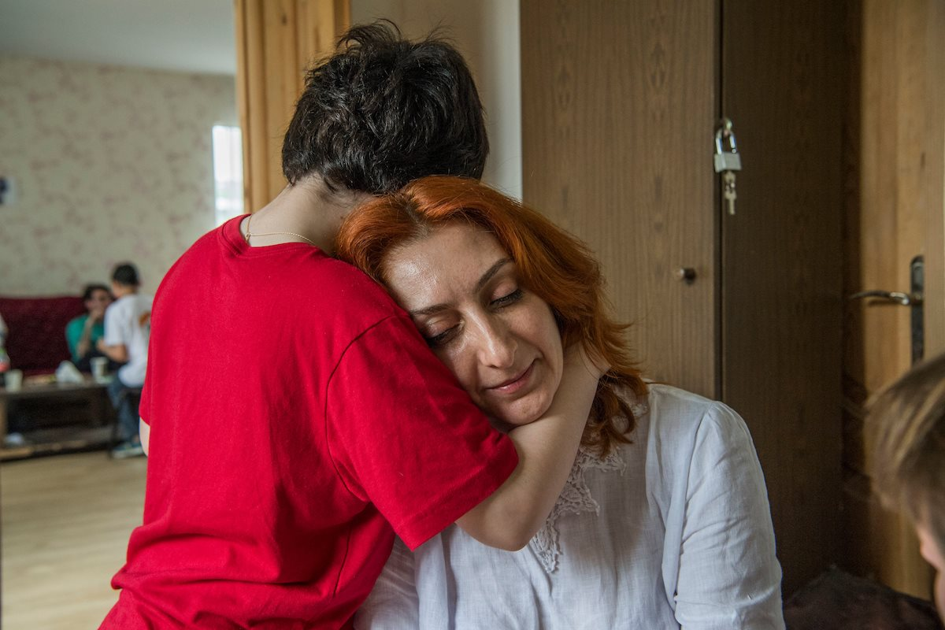
My Reason

Slide 4
Goal of the supporting living
People with disabilities to have dignified life in the community
objectives:
  Family like environment – respected, beloved, heard.
  Increase independency of clients – able to control their own lives
  Promoting social inclusion – member of the community
Notes:
And then, I decided, we have to create service, to support people with disabilities to lead dignified lives in the community. It would be a family-like environment …

Slide 5
Community based housing – supporting living
2011 - in Gurjaani,
  People with intellectual disabilities
2015 - in Tbilisi
  People with intellectual and psychiatric disorders
  6 houses- 27 clients
  Max. 5 persons in one house

Slide 6
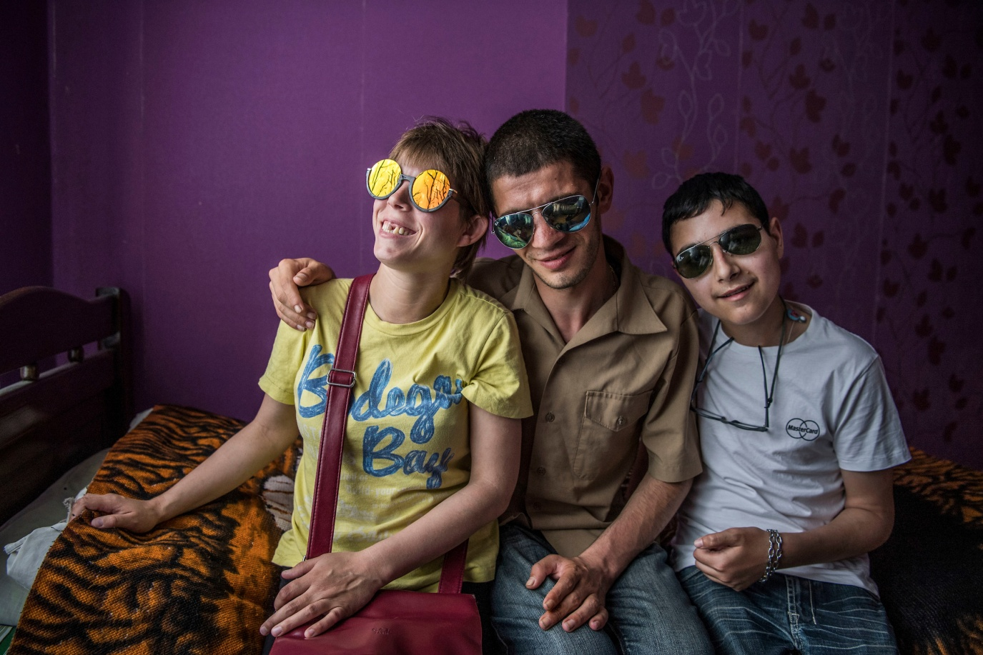
Distinguished housing
Ordinary house in ordinary neighborhood
3-5 person in One house – like typical household
Gives us possibility to see and follow individual needs

Slide 7
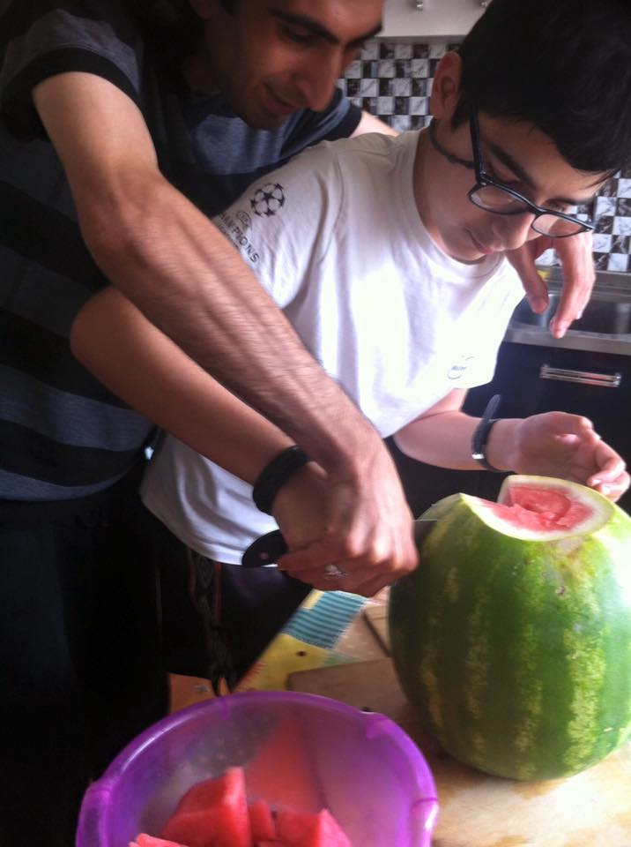
Support
Self determination
Active support
Gentle teaching
Management of challenging behavior

Slide 8
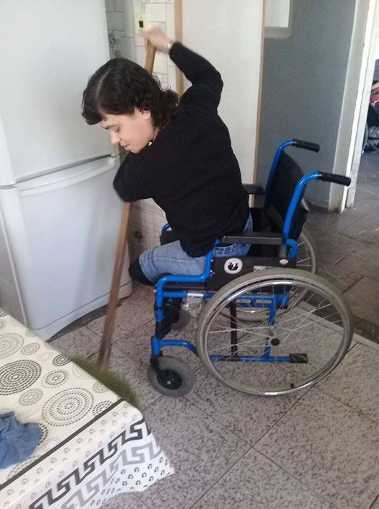
Teaching and assisting
Self-care
Communication and relation
Participation in house and
community activities
Helping them acquire
professions
Assisting in getting jobs

Slide 9
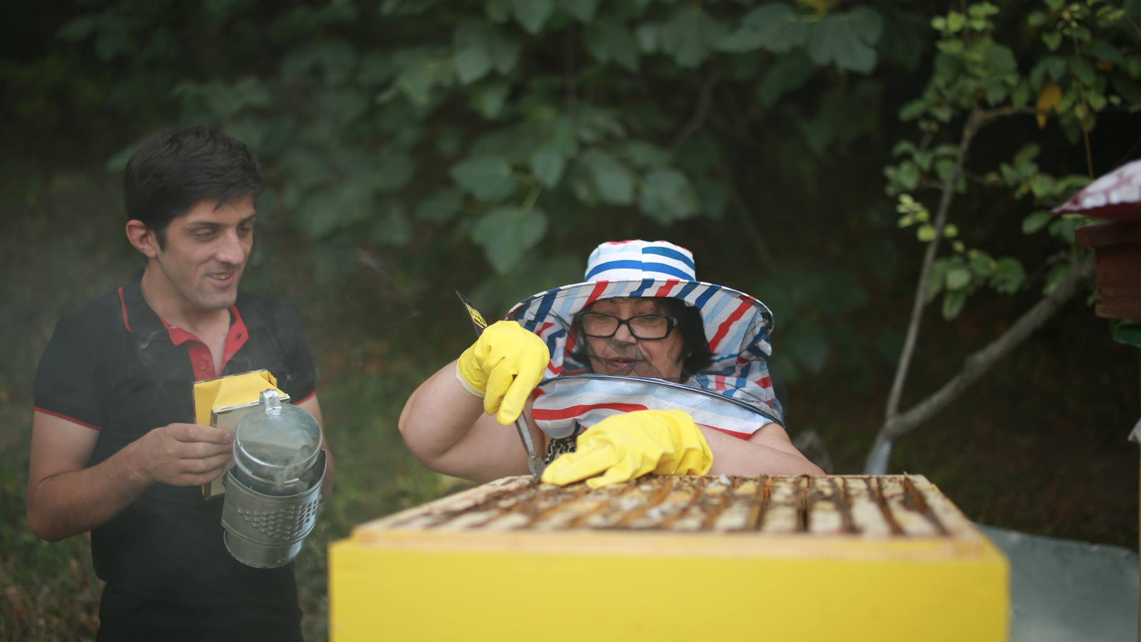
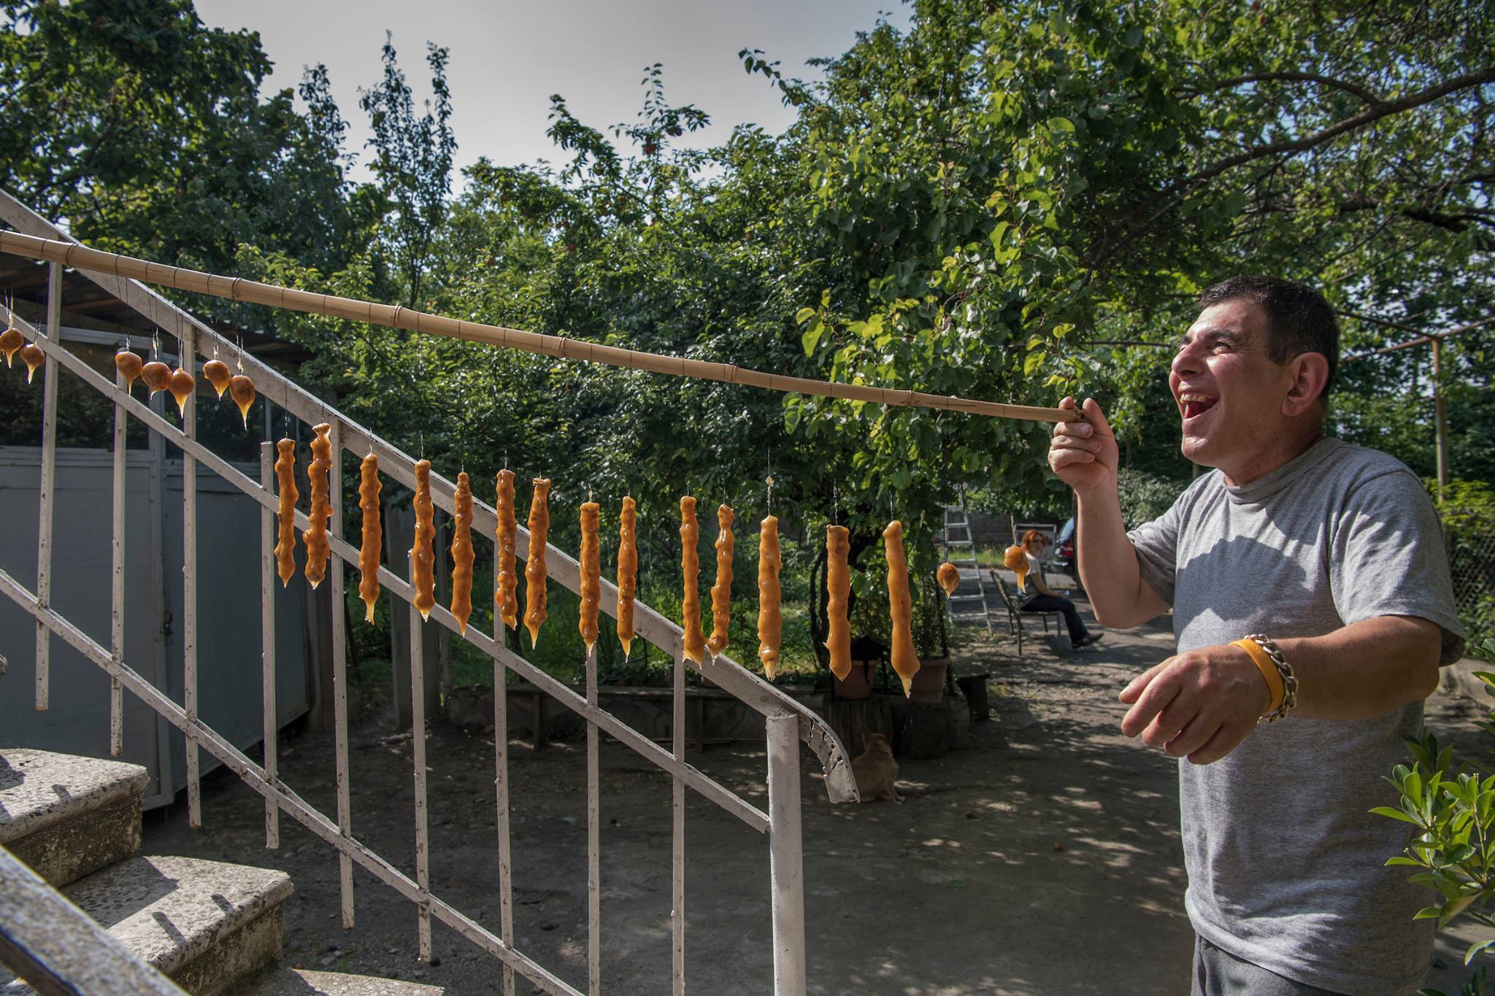
Supporting in enterprise

Slide 10
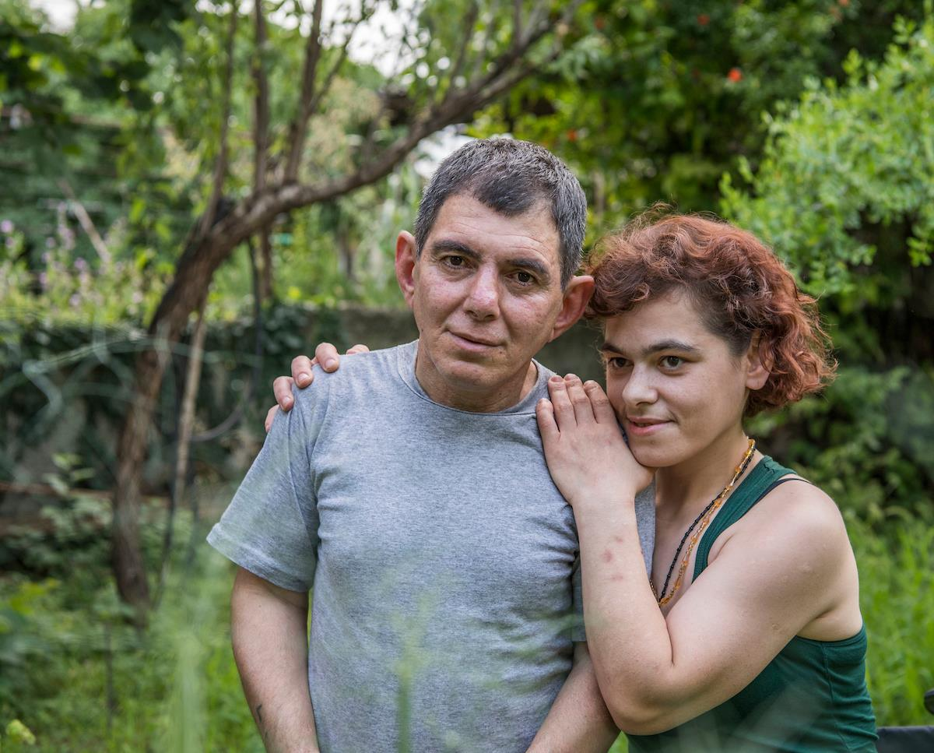
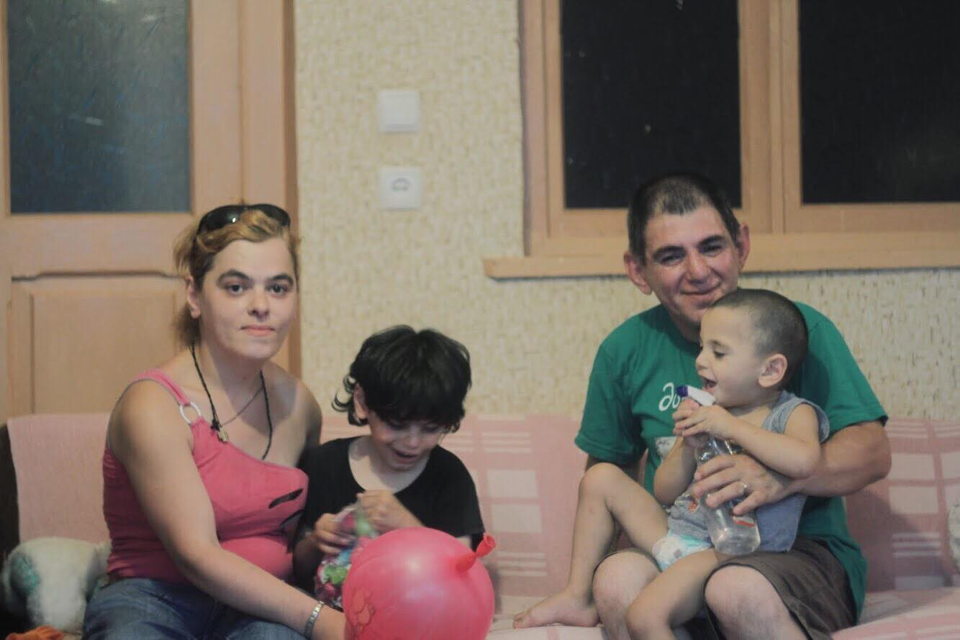
Maintain relations and unifies Families

Slide 11
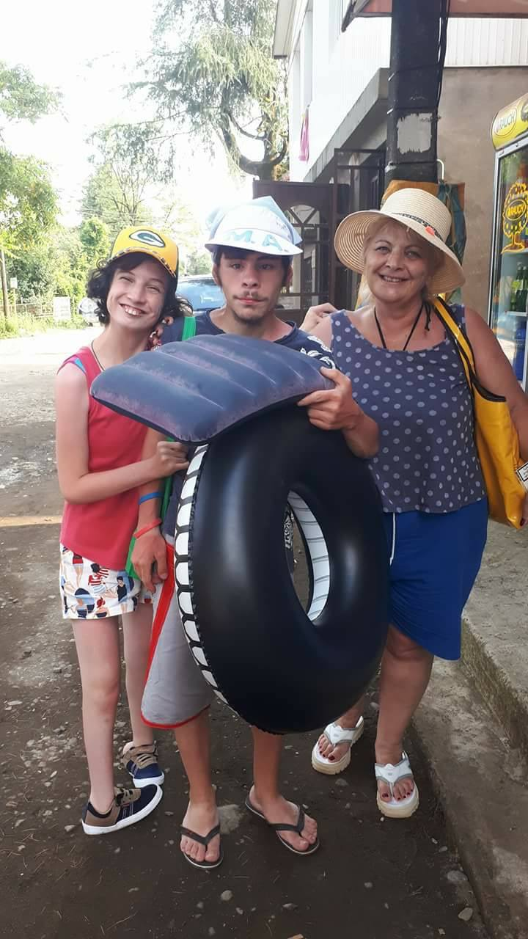
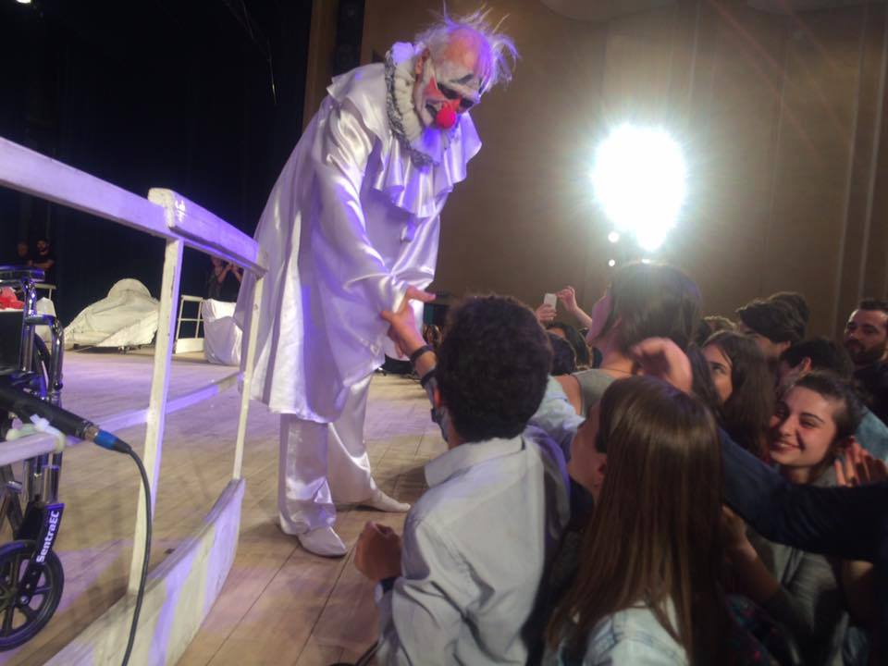
Enjoy life and socialize

Slide 12
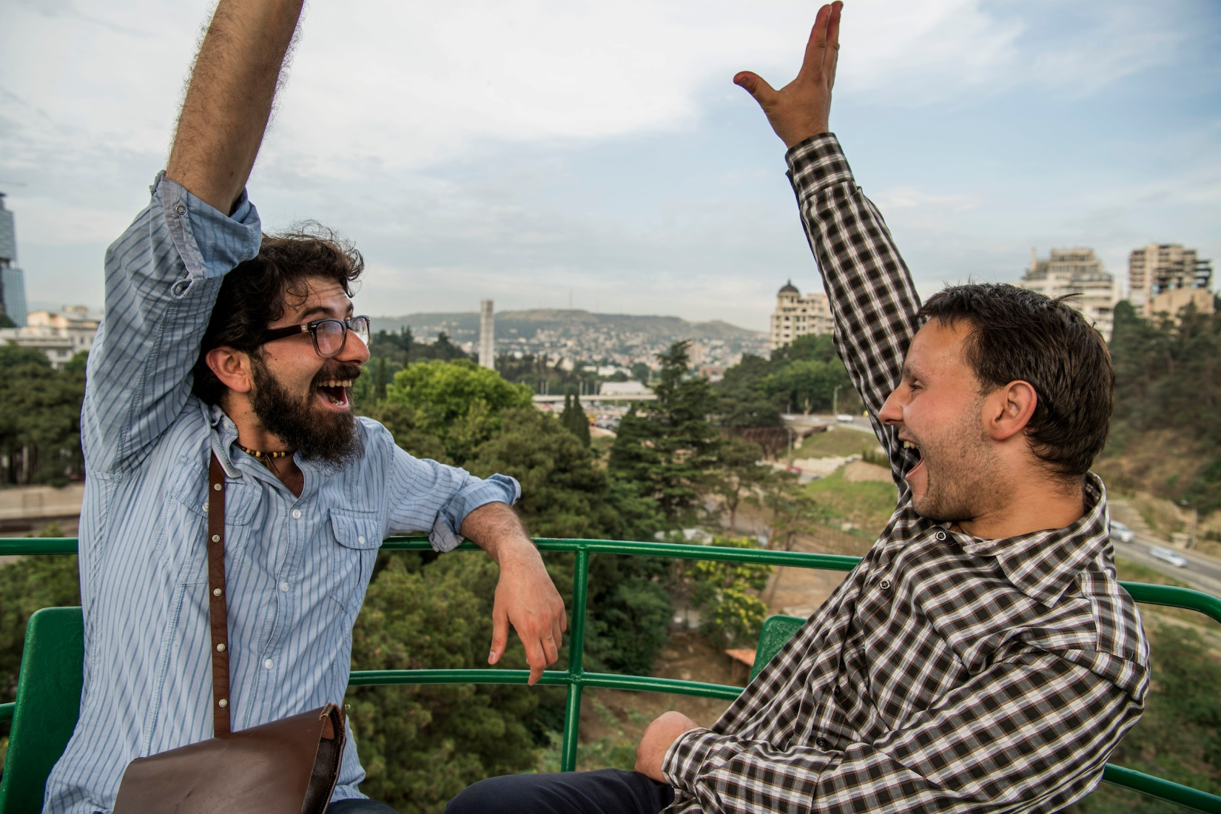
Freedom

Slide 13
Challenge and achievements
Social Innovation
Effective service
Bringing people back to community
Acknowledged – 2017 funded through state programme
Funding increased since 2019
Challenges
  Stigma
  Service is only 2 cities
  Only one service provider

Slide 14
Personal assistance
Established 3 years ago
For children and adults
Beneficiaries – 15
Extremely demanded
Quality of life of family life is increased

Slide 15
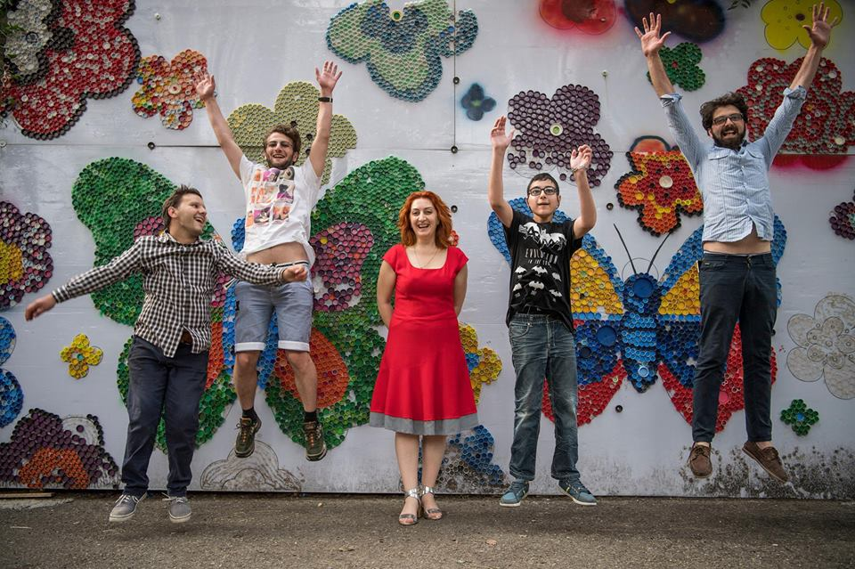
Thank you! maia.shishnia@gmail.com
Facebook/handinhandg www.handinhand.ge

